Slide 1
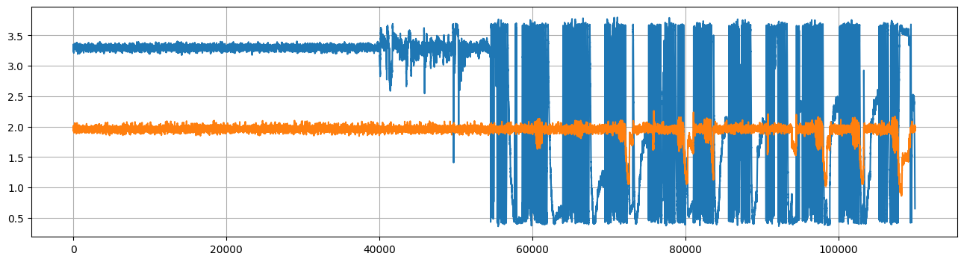
April 28 data wire=259 contact times=259x2=518
Piezo doesn’t match with encoder pattern

Slide 2
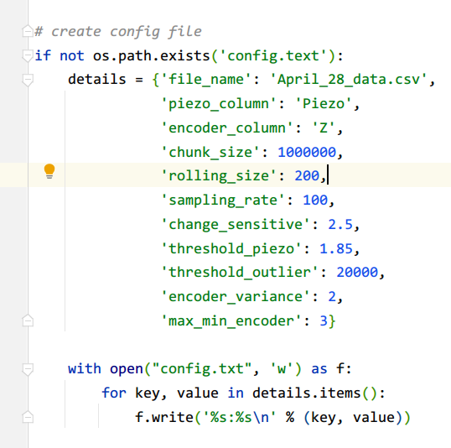
Modification
Change_sensitive: how change point detection algs detect change
Threshold outlier: length of outlier cropped

Slide 3
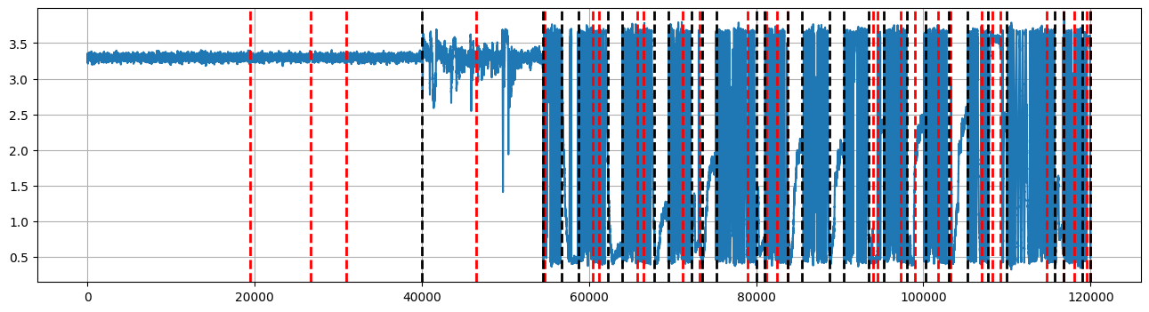
Red line: CPD for piezo data Black: z encoder data

Slide 4
